Slide 1

MedIoT
Summer Intern 2020 – National Institute of technology Andhra Pradesh
Mobile Remote Health Monitoring Kit and Medical Report Generator for Patients
~Aman Kumar Dewangan
Electrical, 5th Sem, National Institute of Technology Raipur
Notes:
Are your classroom colors different than what you see in this template? That’s OK! Click on Design -> Variants (the down arrow) -> Pick the color scheme that works for you!
Feel free to change any “You will…” and “I will…” statements to ensure they align with your classroom procedures and rules!

Slide 2
Problem Statement
The Problem of Monitoring of large no. of patients living in remote areas has been a great issue for almost the whole Medical System of India.
The Time and Money Expenditure required for even monitoring of such patients in remote areas is quite large, compared to those connected to nearby regions with good healthcare facilities.
Highly transmittable disease like COVID19 have forced people to undergo Home Hospitalization and treatment, hence reaching out to everyone whenever in need of immediate monitoring is difficult amid this pandemic.
The General Monitoring Kits available in the market are quite expensive which the general middle class and below poverty line people cannot afford to access.
A Proper management of Patient’s historical records has been a huge problem in consideration, many time leading to late beginning of proper medication and HealthCare Facilities.

Slide 3

Objective
To provide proper patient monitoring equipment's in remote areas, where medical reach is hard or disconnected due to lack of connectivity
To evolve, innovate and renovate the concept of Tele-medicine using IoT and Machine Learning
To promote technical job opportunities for people to work as authorized user of the MedIoT kit.
To evolve a method that automatically generates a pdf containing test results, graphed data and other details in a pdf format which will be sent to a particular doctor’s email id.
To evolve a Machine Learning Algorithm, that would read the report and will generate a possible set of medicines for patient to minimize his/her problems and will automatically highlight the keyword in the document.

Slide 4

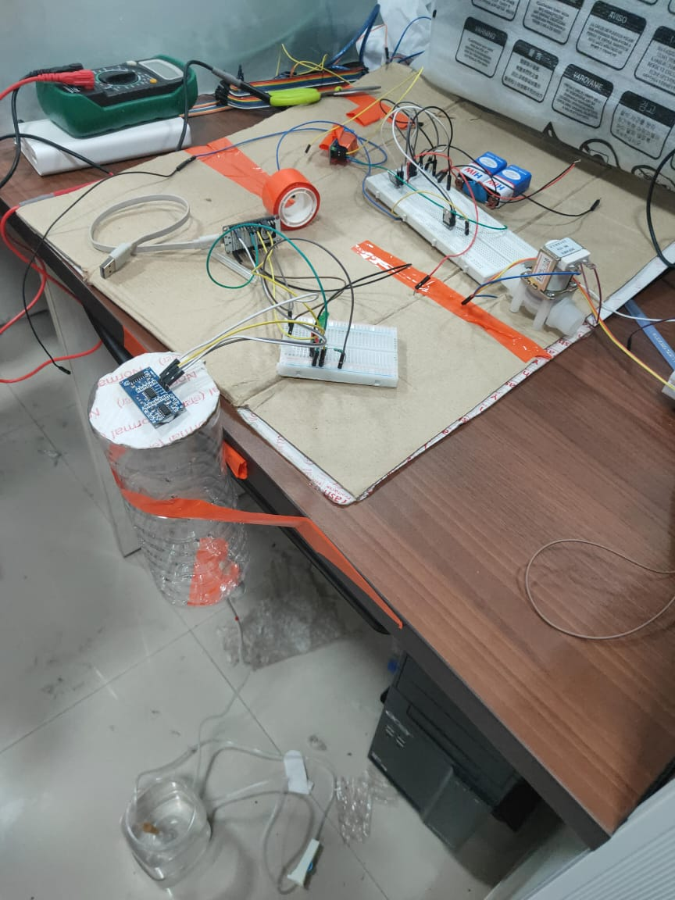
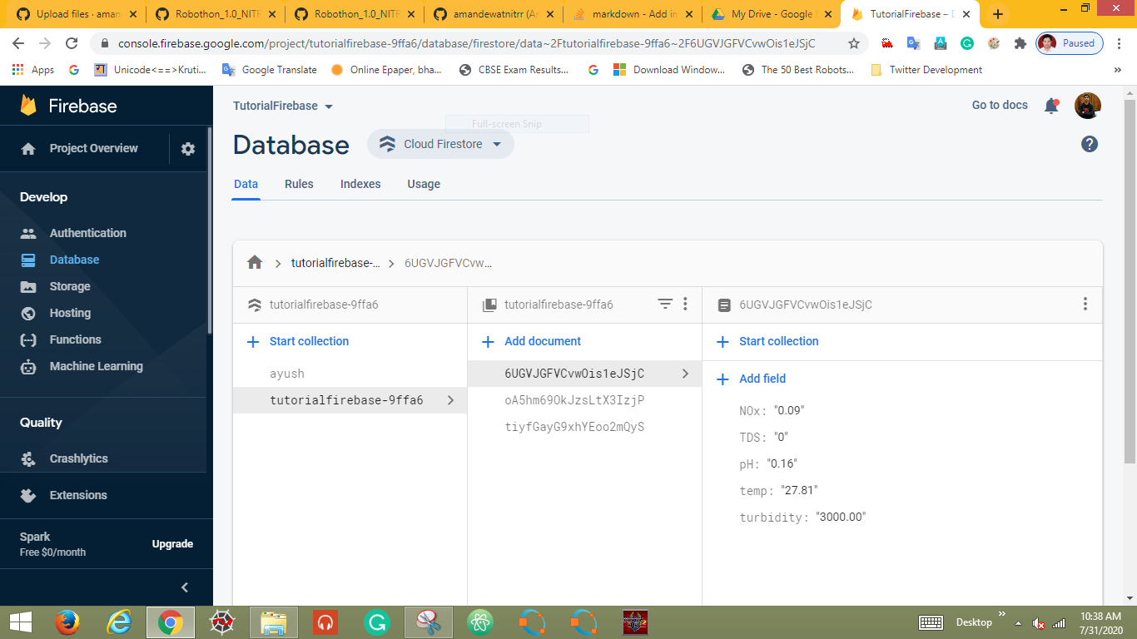
Solution
For this we have our sample website hosted on Raspberry Pi, the initial prototype is developed on Heroku Platform that allows free deployment.
The data is fetched using the ThingSpeak APIs to fetch data and show it over our platform. The data is transmitted in real time and uploaded there itself. Due to lockdown we didn’t have much of the equipment available during this period hence we are using this prototype Drip System for the purpose of showing how the things will work and how the data recorded over cloud and how it will be displayed. It is one of the projects developed by me at National Institute of Technology Raipur.
The figure on the extreme side shows the circuit connection used to retrieve data and the figure at the center shows the CAD Model of the final Product. [**The Above Circuitry is used only to extract the data and send it to the cloud, it has no relation to the project built here.]
The database records the information about real-time NO x , Temperature and other factors associated with the surroundings using Raspberry Pi. The data is collected as separate variables and then collected in a list(to produce a csv format) which can easily be manipulated and fetched.

Slide 5

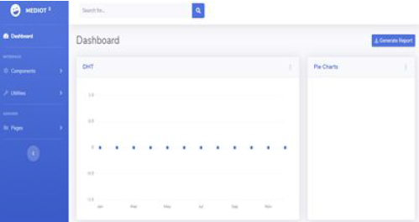
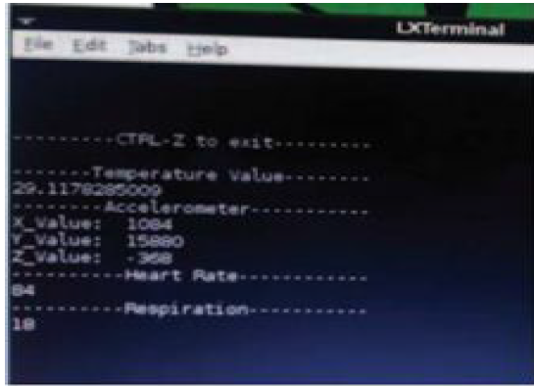
Solution Continued…
Heroku Platform offers free deploying services for prototype apps developed for quick presentation. The Temperature level here is being shown on the Dashboard for instance. The Dashboard receives data from the ThingSpeak/Firebase database on being fetched using API. Though for now we have some issues like manual refreshing in order to know the updated data.

Slide 6
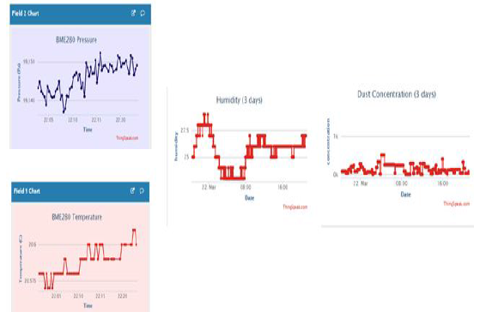
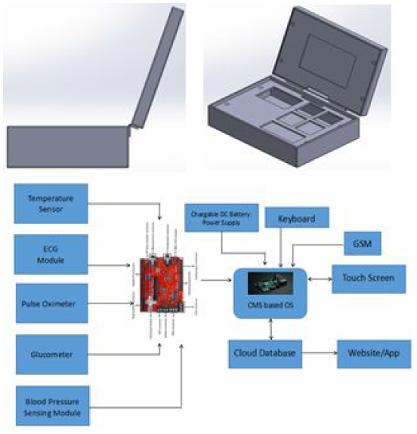
Solution Continued…
The Circuit structure consists of a total 5 sensors which include an ECG Module, Pulse Oximeter, Temperature Sensor, Glucometer, Blood Pressure module connected to a Biometric Shield that manages all the sensors and is connected to Raspberry Pi on which the website is hosted. The Raspberry i is powered using a Common Laptop Battery System for operation and also connected to the input device for user input. The Touch Screen is provided for interactive purposes. The user will only need to perform tests on the patients and the data will be recorded. We have a GSM

Slide 7

Skills Acquired
CAD : Computer Aided Design allows us to design basic 3D appearance of any object. The Skill mentioned has been utilized for making the CAD Model of the box shown in the previous slide, the box would contain the whole system and the test sensors attached to acquire data from patient.
Arduino: Arduino is a very easy programmable Micro-controller that allows easy data fetching from sensors and than allows you to upload it to the cloud via GSM or Wi-Fi technology to the Backend of Website so that data can be stored.
Firebase: Firebase is a backend database used for storing data over cloud. The data from micro-controllers is received on the cloud and stored as variables in documents.
Raspberry Pi: The Data collected from sensors using Arduino and E-Health Sensor Shield is transmitted to Raspberry Pi via COM port, where data is received in CSV format, this data is than split and stored in different variables and than sent over cloud using firebase client function in storage library of Python’s GCP.
Heroku: For testing purpose the app was hosted on Heroku, which offers free deployment for android/ Web/Kotlin apps.
ThingSpeak: ThingSpeak is also a backend system for data storage and utilizes MATLAB Libraries to perform various functions such as Charting, GPS Location etc.
Internet of Things: The Soul base of the complete project is based on IoT, how the micro-controllers/ micro-processors communicate the information to Cloud or Web Server and how computing is performed on it remotely.
Electronics: The Project involves working with large no. sensors, resistors, diodes, transistors etc, for making the circuitry. Hence one must have the complete knowledge about how the voltages and currents are maintained within specified limits keeping in consideration the power consumption of the instrument to be minimum.

Slide 8
Thank You

